Slide 1
NAME: ST FINTINANS LONGWOOD
ORTHOGRAPHIC PROJECTION 11
DATE:
Solid Works Model
Y
25
75
30
20
Y
X
20
30
30
20
ELEVATION
END ELEVATION
100
20
60
20
20
PLAN
Y
Down 130
In 100
SHEET NO: 39

Slide 2
NAME: ST FINTINANS LONGWOOD
ORTHOGRAPHIC PROJECTION 12
DATE:
Solid Works Model
Y
25
25
75
25
X
Y
25
25
50
25
ELEVATION
END ELEVATION
25
75
25
25
PLAN
Y
Down 125
In 90
20
SHEET NO: 40

Slide 3
NAME: ST FINTINANS LONGWOOD
ORTHOGRAPHIC PROJECTION 13
DATE:
Y
50
100
25
25
X
Y
25
50
25
100
END ELEVATION
ELEVATION
25
75
25
25
Y
PLAN
Down 125
In 90
20
SHEET NO: 41

Slide 4
NAME: ST FINTINANS LONGWOOD
ORTHOGRAPHIC PROJECTION 14
DATE:
Y
20
20
20
X
Y
20
30
20
END ELEVATION
ELEVATION
90
40
60
Y
PLAN
Down 125
In 195
SHEET NO: 42

Slide 5
NAME: ST FINTINANS LONGWOOD
ORTHOGRAPHIC PROJECTION 15
DATE:
Y
50
75
25
X
Y
25
ELEVATION
15
15
END ELEVATION
95
20
65
25
20
PLAN
Y
Down 125
In 100
SHEET NO: 43

Slide 6
NAME: ST FINTINANS LONGWOOD
ORTHOGRAPHIC PROJECTION 16
DATE:
Y
20
65
30
15
X
Y
10
20
10
50
20
110
END ELEVATION
ELEVATION
20
70
30
20
PLAN
Y
Down 115
In 90
SHEET NO: 44

Slide 7
NAME: ST FINTINANS LONGWOOD
ORTHOGRAPHIC PROJECTION 17
DATE:
Down 120
In 200 from left
Y
15
45
10
15
85
35
25
X
Y
75
20
25
END ELEVATION
ELEVATION
120
20
35
75
20
Y
PLAN
SHEET NO: 45

Slide 8
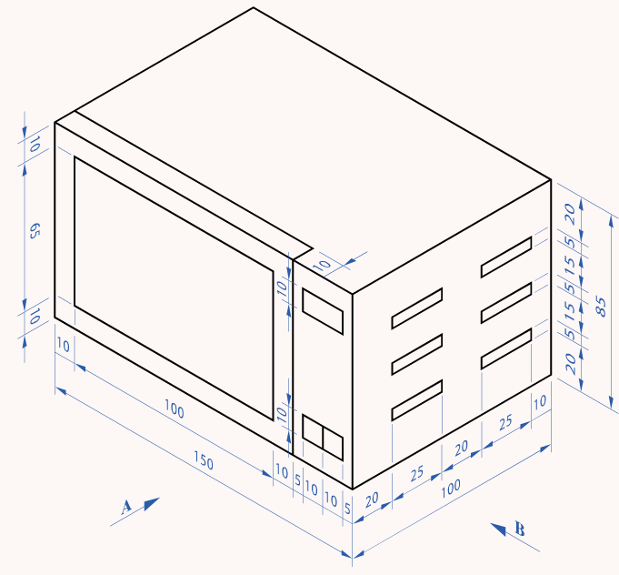
NAME: ST FINTINANS LONGWOOD
MICROWAVE
DATE:
Y
10
20
10
5
15
5
85
15
65
5
20
10
X
10
Y
10
10
10
5
10
25
20
25
10
10
100
10
10
5
END ELEVATION
ELEVATION
150
Super microwave
3000
Super microwave
3000
100
90
Down 110
In 195
10
Y
PLAN
SHEET NO: 46

Slide 9
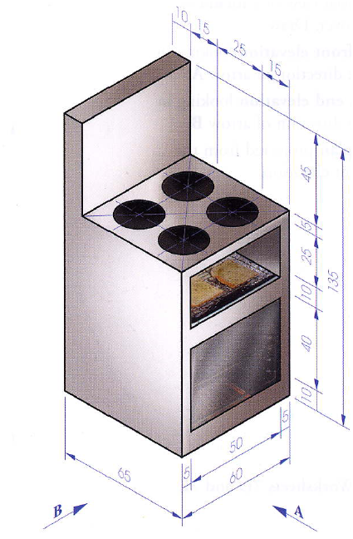
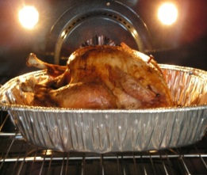
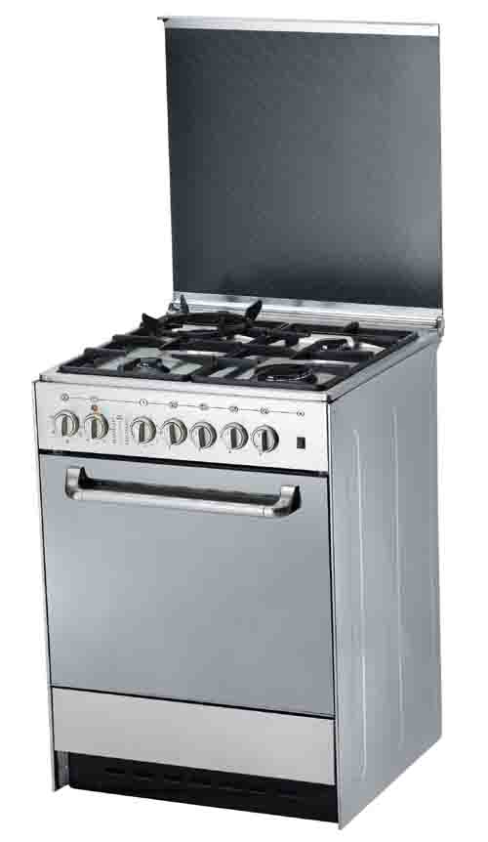
NAME: ST FINTINANS LONGWOOD
COOKER
DATE:
Y
Y
Super Cooker
3000
45
5
25
135
10
40
X
10
Y
5
50
5
ELEVATION
END ELEVATION
60
END ELEVATION
10
15
65
25
The radius of each circle is 10mm
Down 150
In 170
15
Y
PLAN
Y
SHEET NO: 47

Slide 10
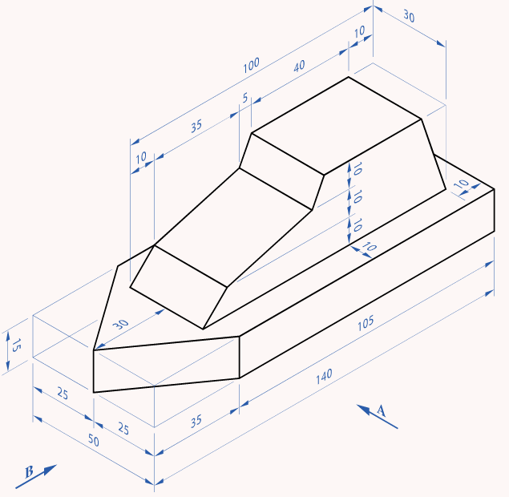
NAME: ST FINTINANS LONGWOOD
SPEED BOAT
DATE:
Y
10
30
10
35
5
40
10
10
10
45
10
X
St. Fintina`s Speed Racer
15
Y
35
105
END ELEVATION
ELEVATION
140
10
25
50
25
10
PLAN
St. Fintina`s Speed Racer
Y
Down 115
In 85
SHEET NO: 48

Slide 11
NAME: ST FINTINANS LONGWOOD
PETROL PUMP
DATE:
45
9
20
Sale:€ 50.00
Price: 134.9 per ltr
Sale:€ 50.00
Price: 134.9 per ltr
18
120
68
38
11
16
END ELEVATION
ELEVATION
END ELEVATION
62
9
22
16
Down 165
In 165
PLAN
SHEET NO: 49

