Slide 1
NAME: ST FINTINANS LONGWOOD
OBLIQUE VIEW 1
DATE:
A pictorial drawing gives an overall impression of what an object looks like.
In oblique drawing the front face of the object is drawn full size. Receding lines are drawn at 45° to the horizontal.
The elevation and plan of a letter F are shown. Draw and Oblique view of the letter
20
20
40
20
140
20
20
120
60
20
20
20
15
15
45°
45°
20
40
40
20
20
20
20
20
20
20
20
100
160
Down 205
In 50
Down 205
In 200
SHEET NO: 50

Slide 2
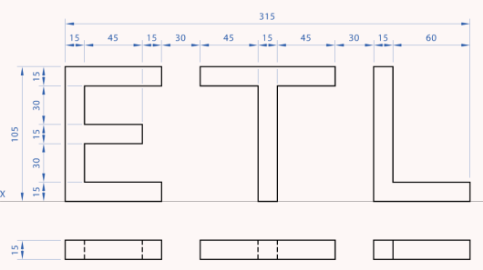
NAME: ST FINTINANS LONGWOOD
OBLIQUE VIEW 2
DATE:
A pictorial drawing gives an overall impression of what an object looks like.
In oblique drawing the front face of the object is drawn full size. Receding lines are drawn at 45° to the horizontal.
The figure below shows the elevation and plan of a logo for Eldon Transport Limited. Draw an Oblique view of the logo.
15
30
120
15
30
15
15
15
40
15
30
45
15
45
30
15
60
45°
315
Down 190
In 35
SHEET NO: 51

Slide 3
NAME: ST FINTINANS LONGWOOD
OBLIQUE VIEW 3
DATE:
A pictorial drawing gives an overall impression of what an object looks like.
In oblique drawing the front face of the object is drawn full size. Receding lines are drawn at 45° to the horizontal.
The figure below shows the elevation and plan of a Robots Face. Draw an Oblique view of the face.
130
20
45°
Grid is made up of 10mm squares.
120
Down 200
In 130
SHEET NO: 52

Slide 4
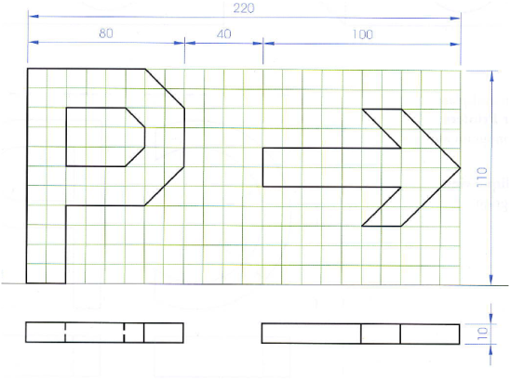
NAME: ST FINTINANS LONGWOOD
OBLIQUE VIEW 4
DATE:
A pictorial drawing gives an overall impression of what an object looks like.
In oblique drawing the front face of the object is drawn full size. Receding lines are drawn at 45° to the horizontal.
The figure below is to be used as a Parking Sign. Draw an Oblique view of the Sign.
110
10
80
40
100
Grid is made up of 10mm squares.
220
Down 200
In 130
SHEET NO: 53

