Slide 1
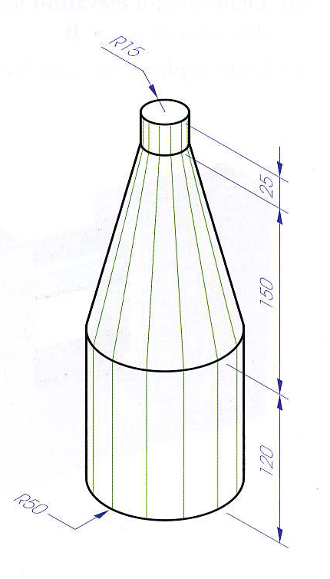
NAME:
RIBENA / PAD LOCK
DATE:
25
150
15
30
75
30
120
15
60
35
30
10
125
20
30
100
30
Down 210
In 90
Down 140
In 220

Slide 2
NAME:
SCHOOL BAG 3000
DATE:
15
10
50
10
15
25
R 50
25
100
50
35
100
50
65
15
Down 135
In 100

Slide 3
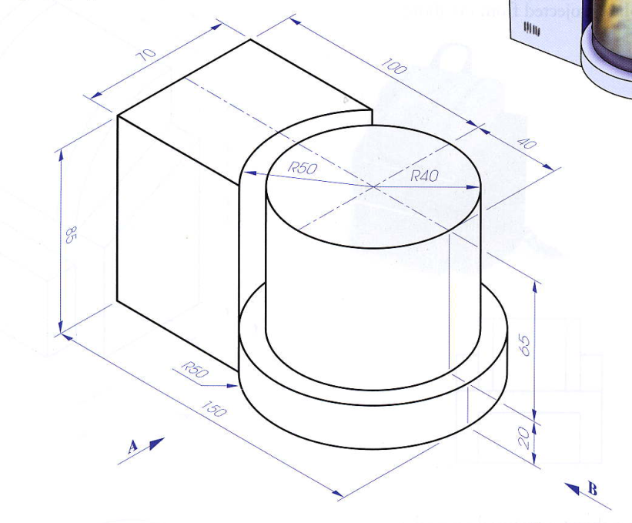
NAME:
FOOD MIXER
DATE:
Down 175
In 280
Elevation A
Plan
Plan B
65
85
20
R 40
R 50
70
100

Slide 4
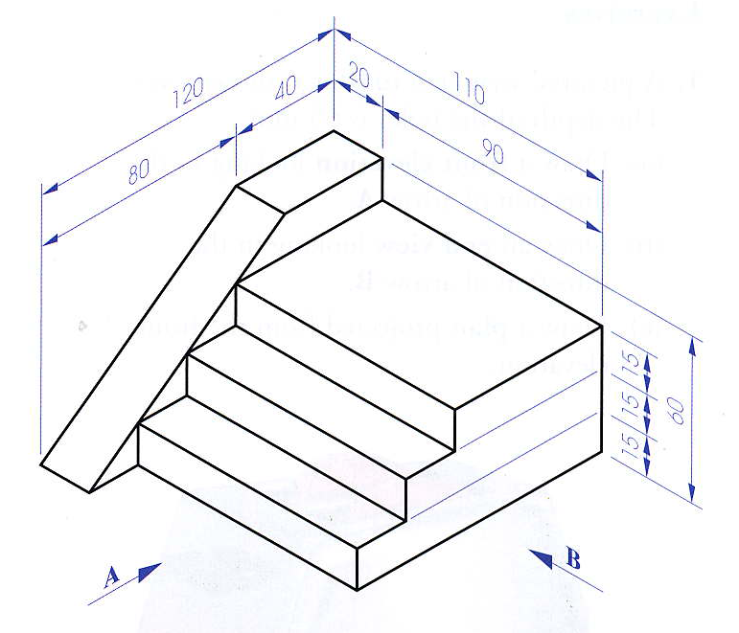
NAME:
FLIGHT OF STEPS
DATE:
Down 90
In 215
Elevation A
Plan
Plan B
60
15
15
15
40
20
90
120
110
40
80
The sloped surface appears as a line in the end view. It is the only view you will get the width of each step. Height is already given.

Slide 5
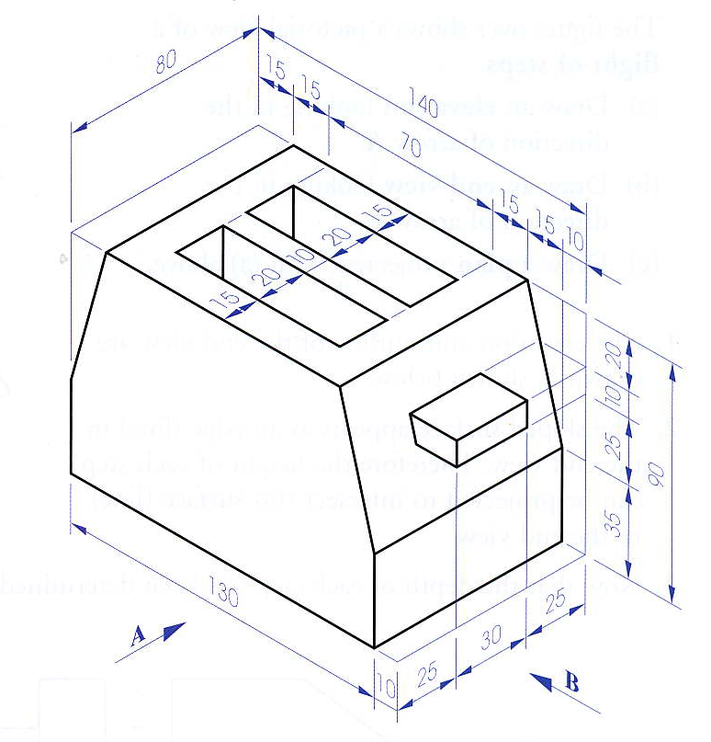
NAME:
TOASTER 3000
DATE:
Down 125
In 185
Elevation A
Plan
Plan B
20
10
65
90
25
35
25
30
25
15
15
70
15
15
10
130
15
20
80
10
20
15

Slide 6
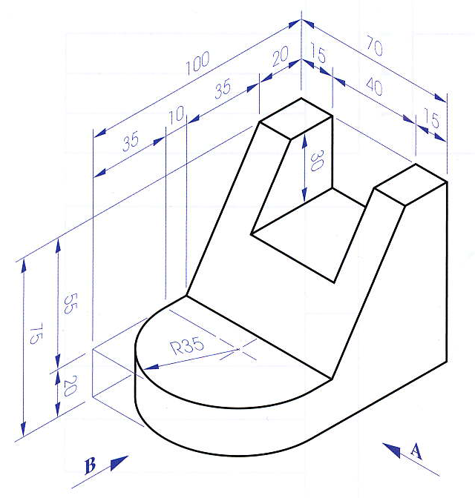
NAME:
SOLID
DATE:
Down 120
In 100
Elevation A
Plan
Plan B
This purple dot is where the blue surface intersects with the edge. The elevation is the only view where you will see these intersect. (object always has to appear as an edge)
30
75
25
20
35
10
35
20
100
15
R 35
70
40
15

Slide 7
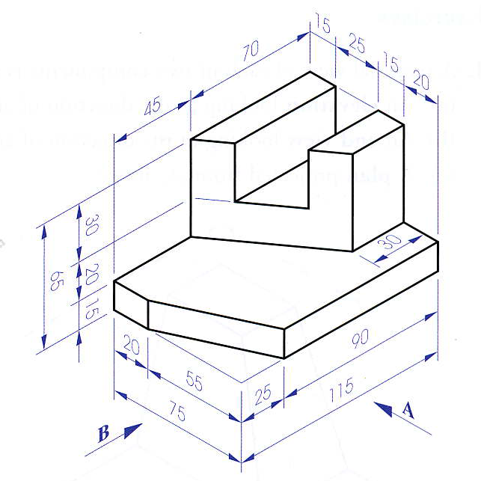
NAME:
SOLID 2
DATE:
This purple dot is where the blue surface intersects with the edge. The elevation is the only view where you will see these intersect. (object always has to appear as an edge)
45
30
65
20
15
25
30
115
20
15
25
75
55
15
20
Down 115
In 95

Slide 8
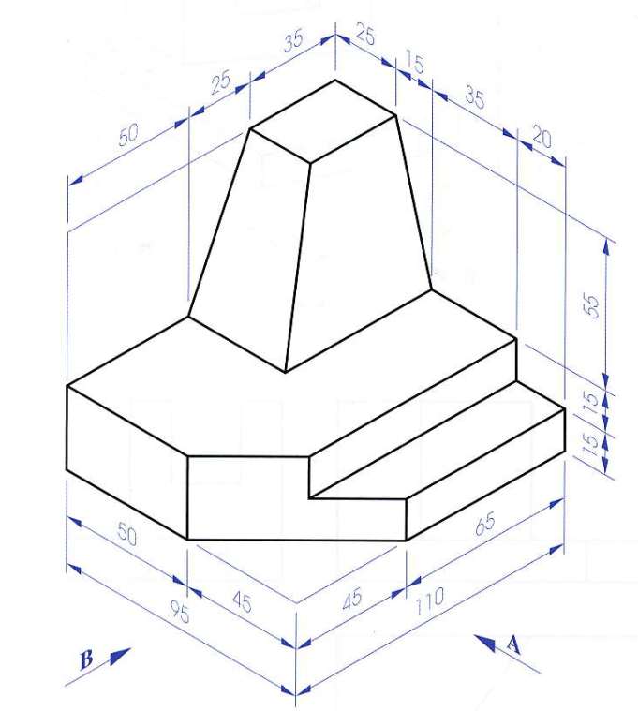
NAME:
SOLID 3
DATE:
This purple dot is where the blue surface intersects with the edge. The elevation is the only view where you will see these intersect. (object always has to appear as an edge)
50
25
35
TRUE SHAPE OF SURFACE
55
85
15
15
45
110
25
Red dot point for compass
50
15
95
35
45
20
Looking at 90°
Down 115
In 120

Slide 9
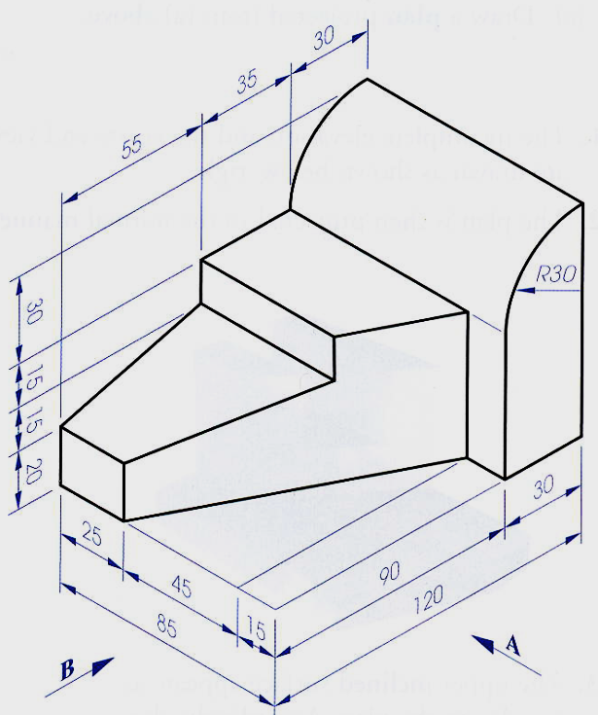
NAME:
SOLID 4
DATE:
TRUE SHAPE OF SURFACE
30
R 30
80
15
15
20
55
35
30
120
25
85
45
Looking at 90°
15
Red dot point for compass
Down 100
In 140

Slide 10
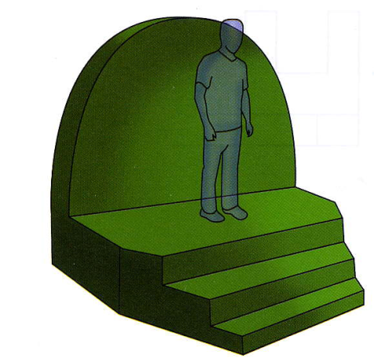
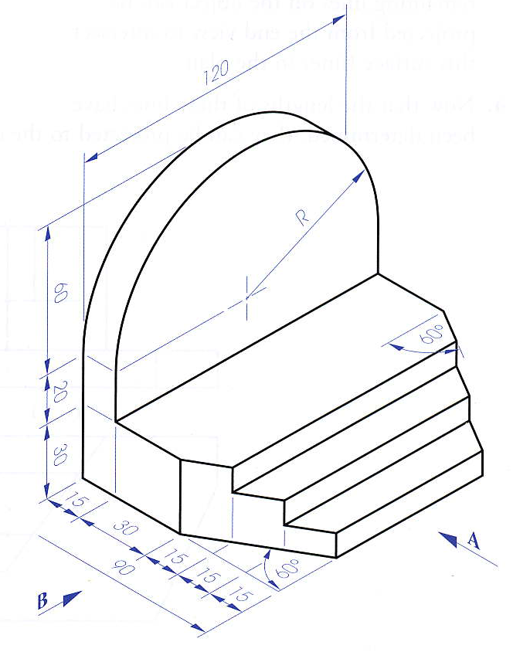
NAME:
PLATFORM
DATE:
60
TRUE SHAPE OF SURFACE
R 60
110
20
30
120
15
30
90
15
Red dot point for compass
15
15
60°
60°
Down 130
In 110
Looking at 90°

Slide 11
Down 115
In 150

Slide 12
NAME:
PLATFORM
DATE:
Down 115
In 150
50
25
25
25
TRUE SHAPE OF SURFACE
30
R 25
60
25
100
15
25
40
15
70
55
125
R 50
25
35
50
85
20
15
Looking at 90°
Red dot point for compass

Slide 13
NAME:
COMPONENT
DATE:
30
70
20
20
40
10
TRUE SHAPE OF SURFACE
40
R 20
R 40
100
30
50
20
20
80
40
140
Red dot point for compass
30
20
80
20
40
30
20
Down 130
In 100
Looking at 90°

Slide 14
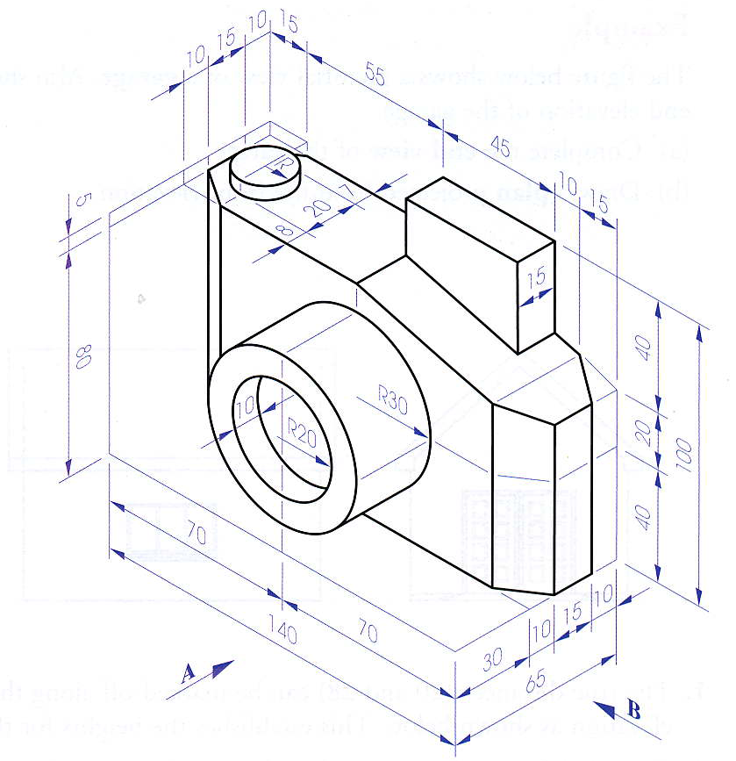
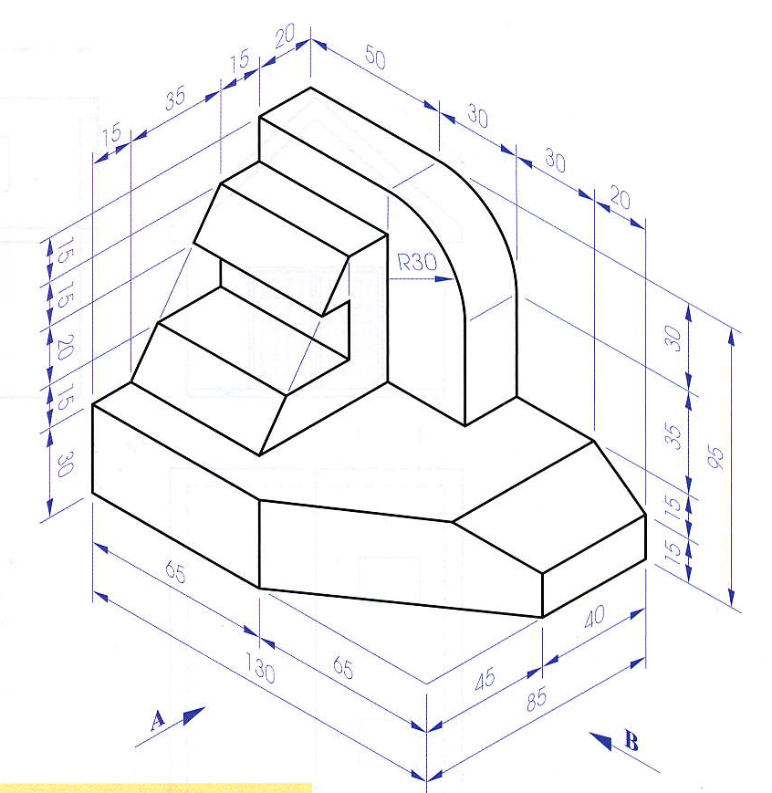
NAME:
OTRHO PG 125
Down 115
In 150
DRAW
ELEVATION IN ARROW A
PLAN
END VIEW IN DIRECTION OF ARROW B
Down 115
In 150

Slide 15
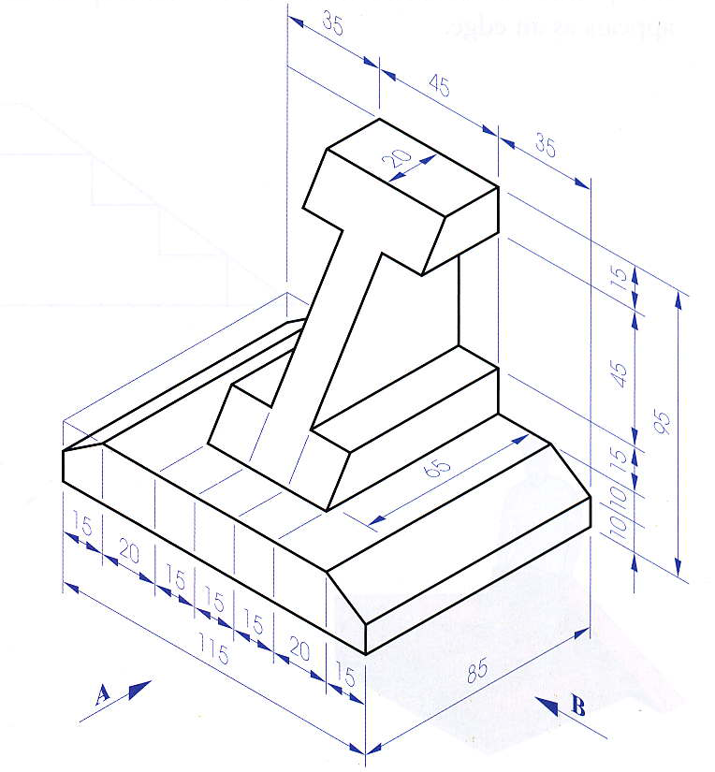
NAME:
SEPTEMBER TEST
DATE:
Down 115
In 150
DRAW
ELEVATION IN ARROW A
PLAN
END VIEW IN DIRECTION OF ARROW B
MARKING SCHEME
ELEV. 20
PLAN 20
EVIEW 20
NEAT 40
TOTAL 100
Down 125
In 185
QUEST 1
100 MARKS
QUEST 2
100 MARKS
A
10 BONUS MARKS FOR FINDING THE TRUE SHAPE OF THE SURFACE A

