Slide 1
NAME:
DEVELOPMENTS POSTERS
DATE:

Slide 2
NAME:
DICE
DATE:
SURFACE DEVELOPMENT OF DICE
50
ELEVATION
PLAN
A DEVELOPMENT IS OBTAINED BY UNFOLDING THE FACES OF AN OBJECT ONTO A PLANE.
DASHED LINES ARE USED TO INDICATE FOLD LINES.
EVERY FACE/SURFACE IN A DEVELOPMENT REPERSENTS THE TRUE SHAPE OF THE FACE OR SURFACE.
Cubes such as dices can be developed in 11 different ways
Down 65
In 15
In 210
In 335
Up 10
30°

Slide 3
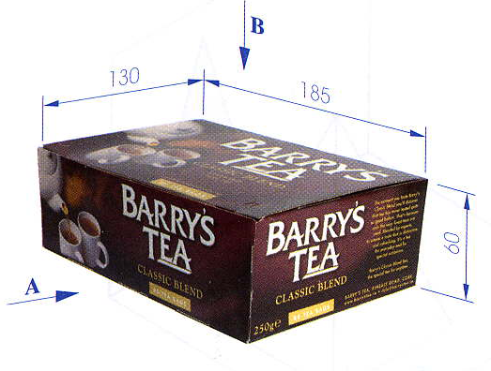
NAME:
BARRYS TEA
DATE:
The box for Barry's Teas Bags shown below, left, is based on a rectangular prism with dimensions as indicated.
Draw an elevation of the prism looking in the direction of the arrow A.
Draw a plan of the prism looking in the direction of arrow A.
Draw a surface development of the prism.
LID
65
30
90
90
BACK
ELEVATION
65
30
SIDE
BASE
SIDE
30
90
30
PLAN
FRONT
Down 110
In 50
In 230

Slide 4
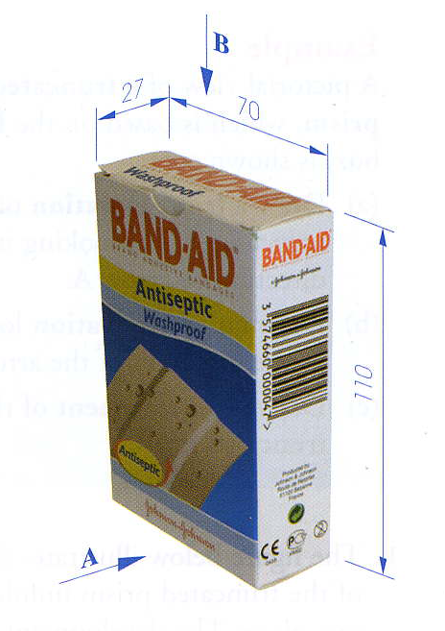
NAME:
BAND AID
DATE:
The Band Aid box shown over is based on a rectangular prism with dimensions as indicated.
Draw an elevation of the prism looking in the direction of the arrow A.
Draw a plan of the prism looking in the direction of the arrow B, projected from the elevation.
Draw a surface development of the prism.
TOP
110
TOP
SIDE
BACK
SIDE
70
70
70
27
BASE
27
SURFACE DEVELOPMENT OF OBJECT
Down 175
In 35
In 270

Slide 5
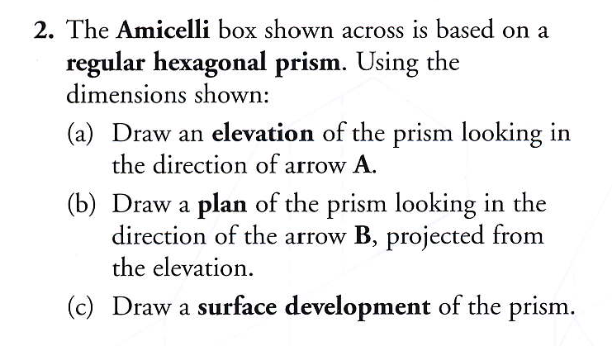
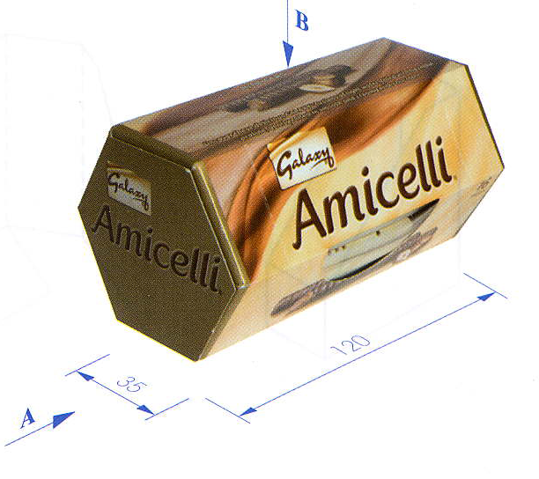
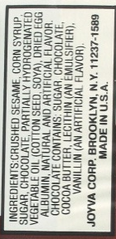
NAME:
GALAXY
DATE:
Hint all sides of the hexagon are 35mm, mark this distance off using your compass when drawing the development
60°
35
120
SURFACE DEVELOPMENT OF OBJECT
Down 80
In 50
Down 188
In 257

Slide 6
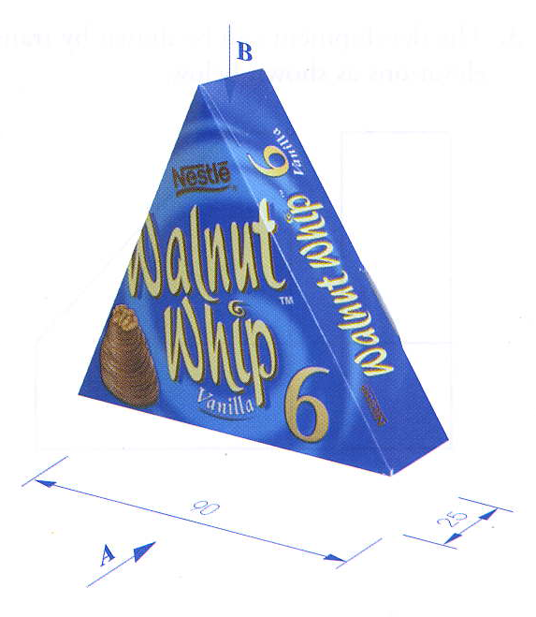
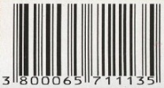
NAME:
WALNUT WHIP
DATE:
SURFACE DEVELOPMENT OF OBJECT
ALTERNATIVE DEVELOPMENT
WALNUT WHIP
WALNUT WHIP
60°
90
25
The Walnut Whip box shown across is based on a equilateral triangle prism. Using the dimensions indicated.
Draw an elevation of the prism looking in the direction of the arrow A.
Draw a plan of the prism looking in the direction of the arrow B, projected form the elevation.
Draw a surface development of the prism.
WALNUT WHIP
Down 160
In 45
Down 160
In 45

Slide 7
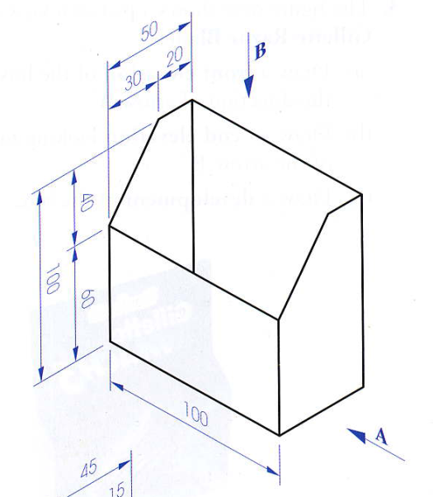
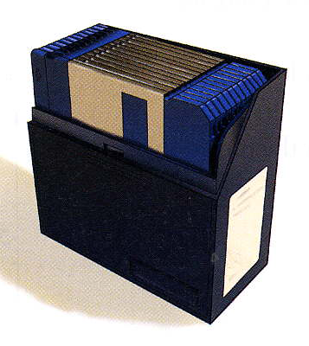
NAME:
FLOPPY DISK HOLDER
DATE:
30
20
100
30
20
40
100
SIDE
SIDE
BACK
SIDE
60
30
20
50
50
BASE
50
A pictorial view of a Disk Box is shown over.
Draw a front elevation of the box in the direction of the arrow A.
Draw a plan looking in the direction of the arrow B, projected from the elevation.
Draw a development of the box.
FRONT
100
BASE
FLOPPY DISK HOLDER 3000
FLOPPY DISK HOLDER 3000
60
Down 120
In 35
In 215
SURFACE DEVELOPMENT OF OBJECT
PLAN

Slide 8
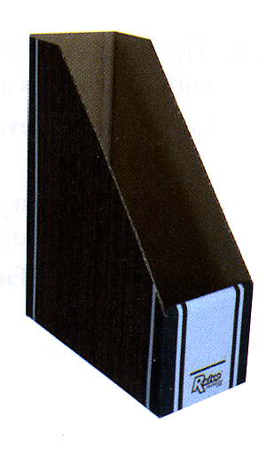
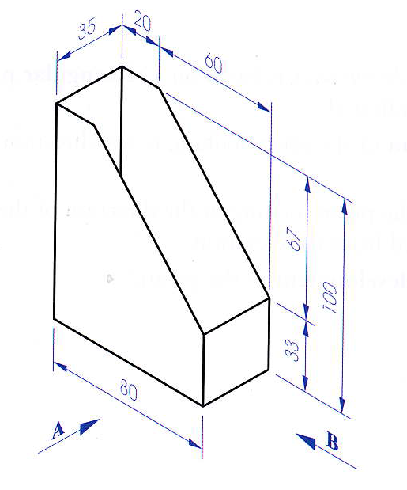
NAME:
LEAFLET HOLDER
DATE:
A pictorial view of a truncated prism, which is based on the Leaflet Holder, is shown over.
Draw an elevation of the truncated prism looking in the direction of the arrow A.
Draw an end elevation looking in the direction of the arrow B.
Draw a surface development of the truncated prism.
100
20
60
80
35
SURFACE DEVELOPMENT OF OBJECT
Down 160
In 65
In 280

Slide 9
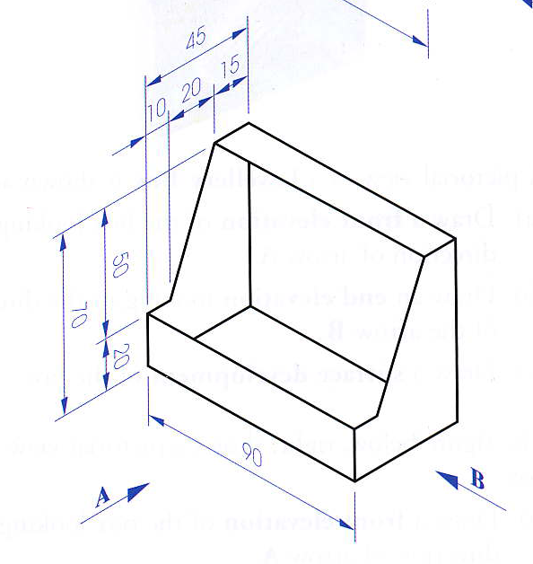
NAME:
TEST
DATE:
A pictorial view of a display box is shown. Draw:
A front Elevation looking in the direction of Arrow A.
Draw a Plan
Draw a end view in the direction of arrow B.
Draw the surface development of the object.
Marking Scheme
Elevation 10%
Plan 10%
End View 10%
Development 40%
Neatness and Accuracy 30%
TOTAL = 100%
BACK
ELEVATION
BACK
Down 140
In 80
In 250

Slide 10
NAME:
TEST SOLUTION
DATE:
A pictorial view of a display box is shown. Draw:
A front Elevation looking in the direction of Arrow A.
Draw a Plan
Draw a end view in the direction of arrow B.
Draw the surface development of the object.
Marking Scheme
Elevation 10%
Plan 10%
End View 10%
Development 40%
Neatness and Accuracy 30%
TOTAL = 100%
TOP
SIDE
BACK
SIDE
BASE
FRONT
Down 140
In 80
In 250

Slide 11
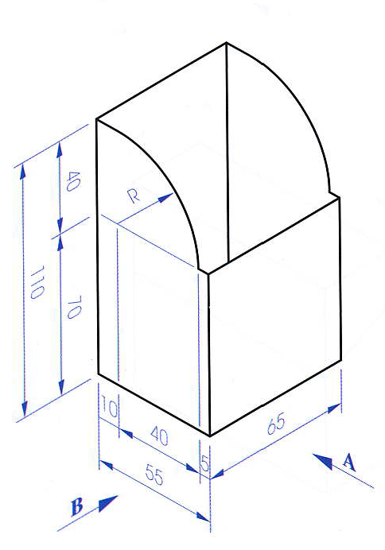
NAME:
DISPLAY BOX
DATE:
BACK
65
ELEVATION
The figure over shows a Display Box.
Draw a front elevation of the box looking in the direction of arrow A.
Draw a plan below elevation
Draw and end elevation looking in the direction of the arrow B
Draw a development of the box.
Down 120
In 30
In 255

Slide 12
NAME:
DISPLAY BOX
DATE:
40
110
70
10
40
5
65
55
The figure over shows a Display Box.
Draw a front elevation of the box looking in the direction of arrow A.
Draw a plan below elevation
Draw and end elevation looking in the direction of the arrow B
Draw a development of the box.
Down 140
In 80
In 250

Slide 13
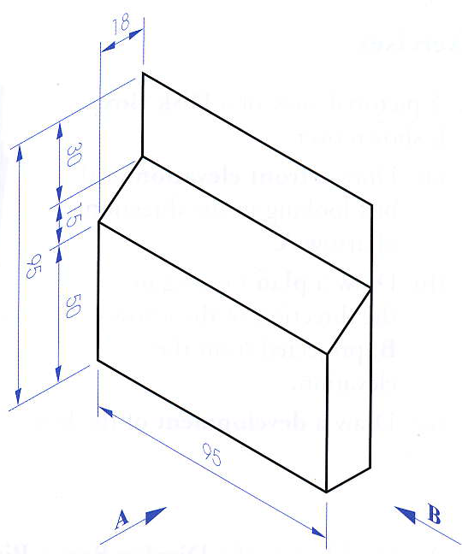
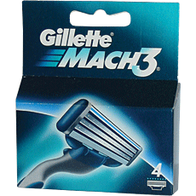
NAME:
GILLETE
30
15
95
BACK
SIDE
SIDE
50
18
95
BASE
95
18
FRONT
The figure over shows a pictorial view of a box for Gillette Razor Blades.
Draw a front elevation of the box looking in the direction of arrow A.
Draw a plan directed from the elevation.
Draw and end elevation looking in the direction of the arrow B
Draw a development of the box.
LID
Down 140
In 80
In 250

Slide 14
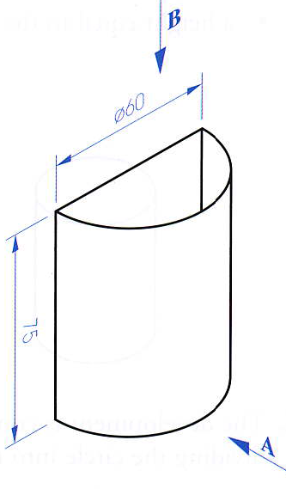
NAME:
BIN SLIM 3000
The figure over shows a pictorial view of a Bin Slim 3000
Draw an elevation of the bin looking in the direction of the arrow A.
Draw a plan looking in the direction of the arrow B, projected from the elevation.
Draw an end view to the left of the elevation.
Draw a development of the bin.
Step 1. Draw Circle
Step 2. Divide using 60/30
75
9
3
4
5
6
7
8
9
Get your compass, measure distance from point 3 to 4, the mark this distance off a number of times on the development.
9
3
8
4
7
6
5
8
4
7
6
5
60
Down 175
In 130
In 225

Slide 15
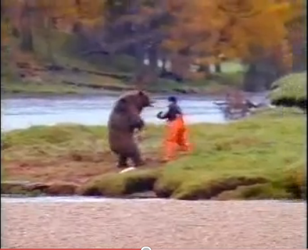
NAME:
JOHN WEST
A pictorial view of a prism, which is based on the Herring Fillets box is shown below.
Draw an elevation of the prism looking in the direction of the arrow A.
Draw a plan looking in the direction of the arrow B, projected from the elevation.
Draw a surface development of the prism.
6
7
8
15
11
12
9
10
10
11
12
9
11
10
8
12
9
7
6
40
8
50
7
6
15
20
50
20
Down 120
In 112
Down 155
In 260

Slide 16
NAME:
CONTAINER
The figure over shows a pictorial view of a container.
Draw an elevation of the prism looking in the direction of the arrow A.
Draw a plan projected from the elevation.
Draw an end elevation projected in the direction of the arrow B.
Draw a development of the container.
30
90
40
20
100
CONTAINER
SIDE
BACK
SIDE
60
3
6
20
R30
4
5
5
20
90
6
4
3
90
4
CONTAINER
30
30
100
5
6
CONTAINER
30
Down 140
In 30
In 255

Slide 17
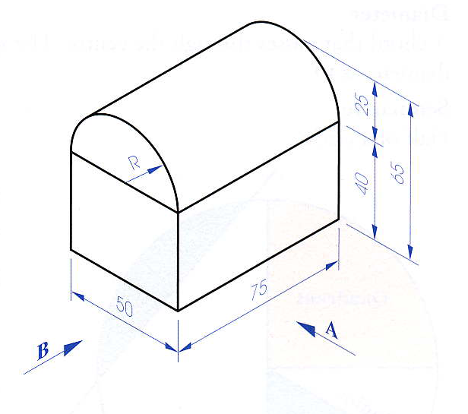
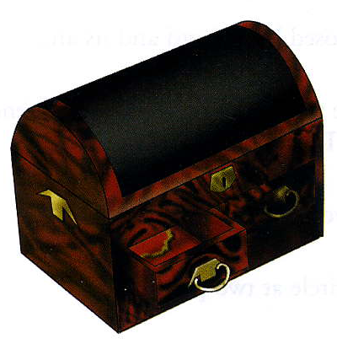
NAME:
JEWELLERY BOX
A Pictorial view of a Jewellery Box is shown across
Draw an elevation of the prism looking in the direction of the arrow A.
Draw a plan projected from the elevation.
Draw an end elevation projected in the direction of the arrow B.
Draw a surface development of the box.
9
10
11
12
LID
11
12
1
11
12
1
1
25
10
2
10
2
9
3
9
3
SIDE
BACK
SIDE
40
75
75
BASE
50
FRONT
Down 135
In 20
In 250

Slide 18
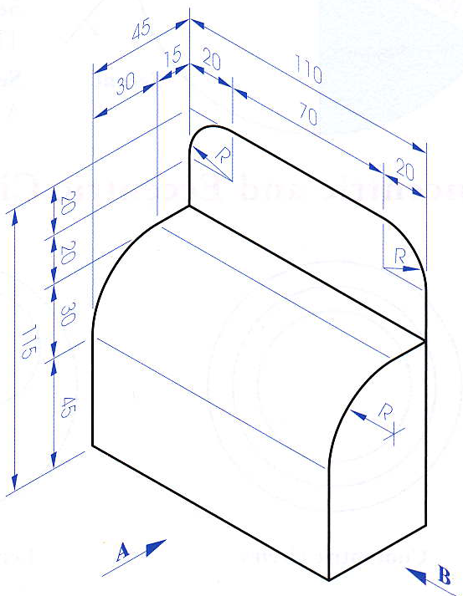
NAME:
STORAGE BOX
A2 SHEET REQUIRED
20
20
20
11
12
20
11
12
10
30
115
10
R30
9
9
45
30
110
50
A Pictorial view of a Storage Box is shown across
Draw an elevation of the prism looking in the direction of the arrow A.
Draw a plan projected from the elevation.
Draw an end elevation projected in the direction of the arrow B.
Draw a surface development of the box.
9
10
11
12
Down 170
In 120
In 350

