Slide 1
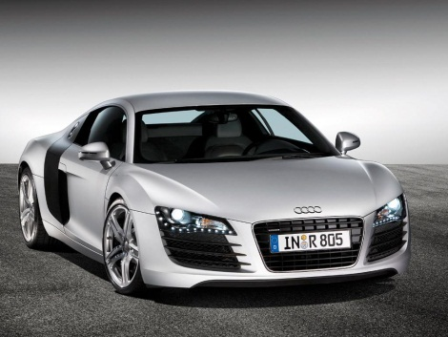
CAR LOGOS
4
R24
R60
Ø22
R31
41
Down 135
In 65
Down 135
In 95
SHEET NO: 13

Slide 2
DELL
DATE:
R74
R70
9
3.5
8
9
3.5
36
9
7
16
34
10
35°
13
18
20
20
12
12
12
12
2
The Bottom of E is 2mm below.
All sides of the E are 34mm.
Down 130
In 200
SHEET NO: 15

Slide 3
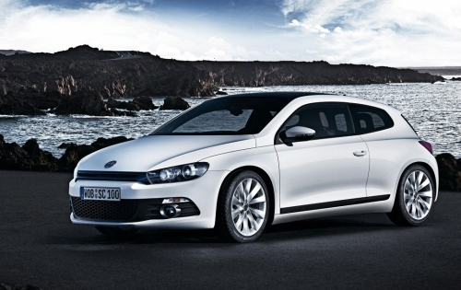
VOLKSWAGON
DATE:
50
50
15
Ø200
10
20
20
The drawing of the Volkswagon symbol is shown in the figure below, it includes the letteres V and W in a circular logo. Draw the full size logo.
Down 130
In 200
35
35
SHEET NO: 16

Slide 4
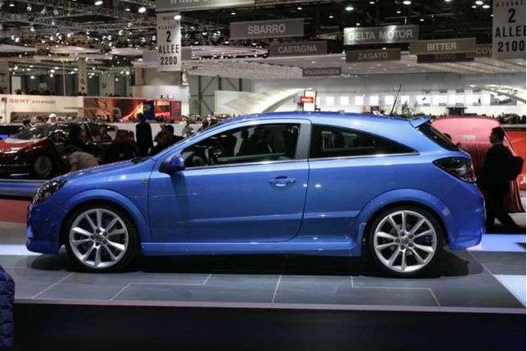
OPEL
DATE:
10
40
10
10
10
45°
10
40
Draw middle section first, leave circles to last.
Down125
In 190
20
Ø190
20
SHEET NO: 17

Slide 5
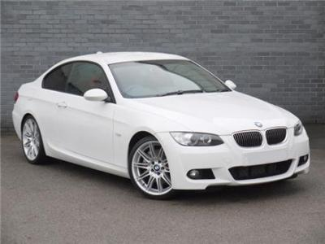
BMW
DATE:
53°
R 100
R96
Draw Letters BMW first and finish by drawing circles.
Down129
In 200
“THE ULTIMATE DRIVING MACHINE”
SHEET NO: 18

